Slide 1
Trabajo integrador de pcse
Trabjo: Driver para sensor DHT11 / DHT22
Docente: Mg. Ing. Gonzalo E. Sánchez
Alumno: Ing. Jhonny A. Velasco

Slide 2




Agenda:
Alcance
Fichas técnicas
Desarrollo del Driver
Pruebas

Slide 3


alcance
Realizar la implementación de un driver para un sensor digital de temperatura y humedad (DHT11 / DHT22).
Debe ser compatible con la placa ST NUCLEO-F429ZI que está basada en arquitectura ARM Cortex-M.
El driver deberá ser modular y escalable para varias arquitecturas y microcontroladores.
El driver es de tipo Polled o encuesta.

Slide 4


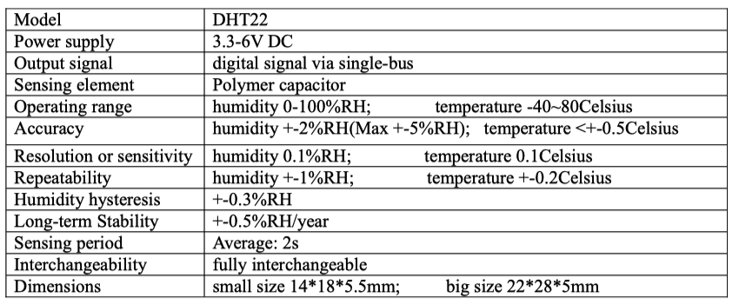
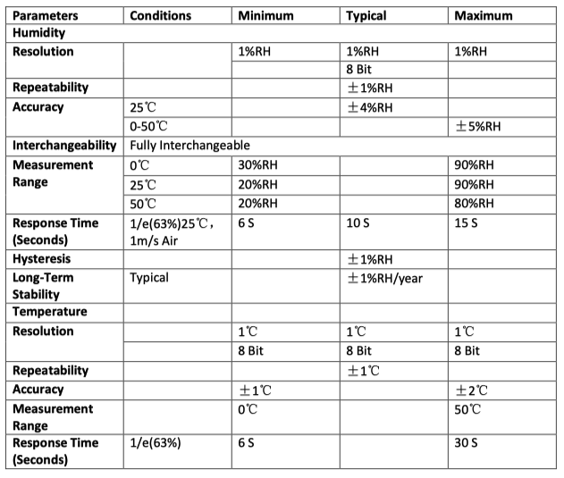
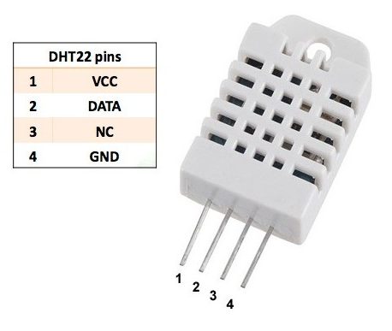
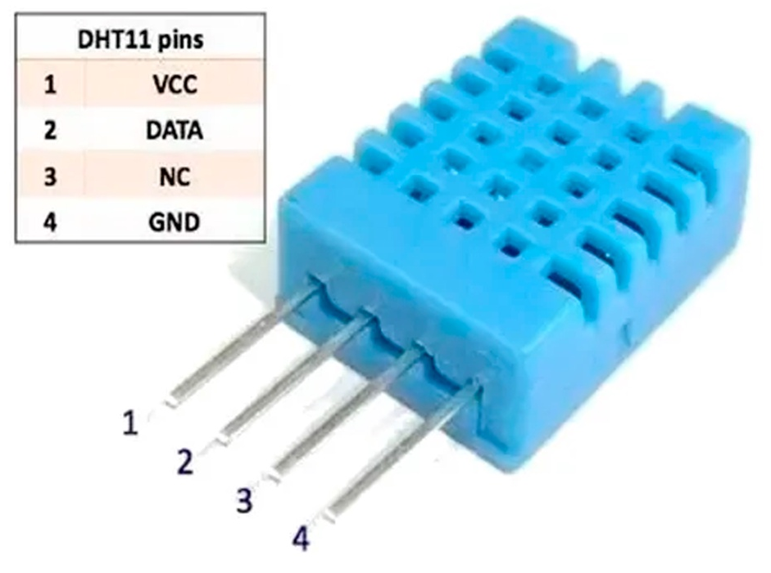
Fichas técnicas
DHT11
DHT22
Figure 2 DHT22 Datasheet.
Figure 1 DHT11 Datasheet.

Slide 5

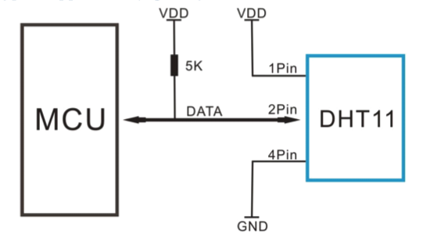

Fichas técnicas
DHT11’s power supply is 3-5.5V DC. When power is supplied to the sensor, do not send any instruction to the sensor in within one second in order to pass the unstable status. One capacitor valued 100nF can be added between VDD and GND for power filtering.
Single-bus data format is used for communication and synchronization between MCU and DHT11 sensor.
Data consists of decimal and integral parts. A complete data transmission is 40bit, and the sensor sends higher data bit first.
Data format: 8bit integral RH data + 8bit decimal RH data + 8bit integral T data + 8bit decimal T data + 8bit check sum. If the data transmission is right, the check-sum should be the last 8bit of "8bit integral RH data + 8bit decimal RH data + 8bit integral T data + 8bit decimal T data".
Figure 3 Typical Application.
Note: 3Pin – Null; MCU = Micro-computer Unite or single chip Computer
When the connecting cable is shorter than 20 metres, a 5K pull-up resistor is recommended; when the connecting cable is longer than 20 metres, choose a appropriate pull-up resistor as needed.

Slide 6
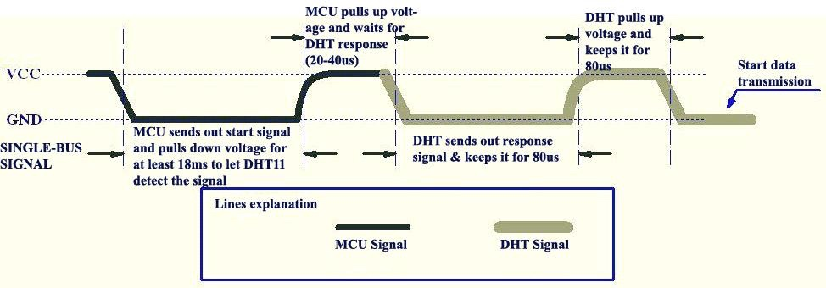
Fichas técnicas
Figure 4 MCU sends out START signal & DHT11 Responses.

Slide 7
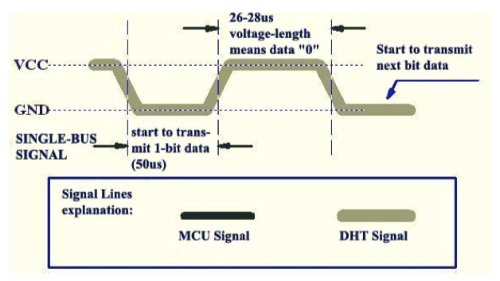
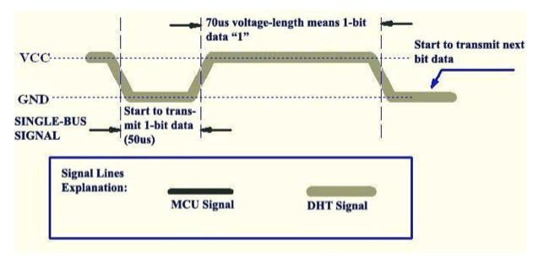
Fichas técnicas
Figure 5 DHT sends Data, Data “0” indication.
Figure 6 DHT sends Data, Data “1” indication.

Slide 8

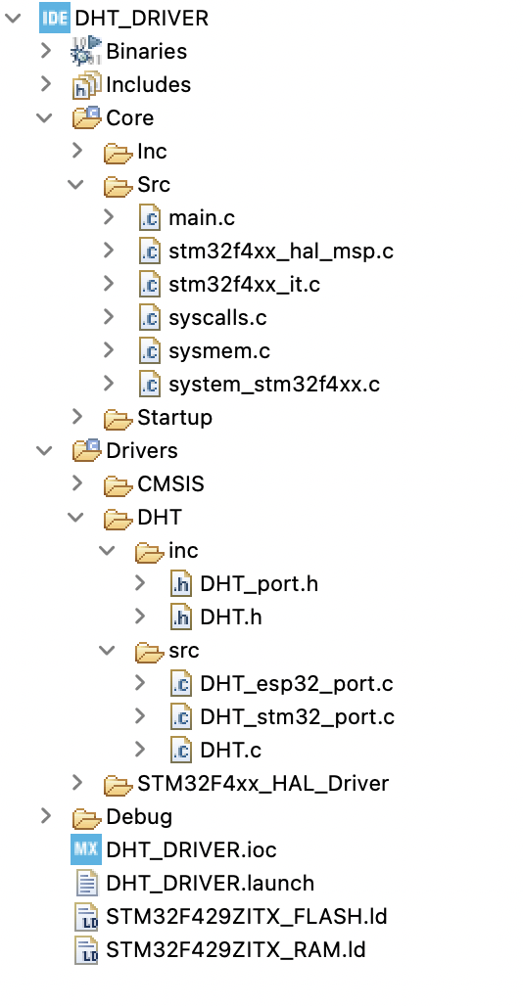
Desarrollo del driver
Funciones públicas en DHT.h
DHT_STATUS DHT_init ( DHT_TYPE model, uint8_t gpio );
void DHT_errorHandler ( DHT_STATUS response );
DHT_STATUS DHT_readSensor ( );
float DHT_getHumidity ( );
float DHT_getTemperature ( );
Funciones internas en DHT_stm32_port.h
void _set_gpio_mode ( uint8_t DHT_pin, uint8_t gpio_mode );
void _set_gpio_level ( uint8_t DHT_pin, uint8_t level );
uint8_t _get_gpio_level ( uint8_t DHT_pin );
void _set_delay_us ( uint32_t uSeconds );

Slide 9

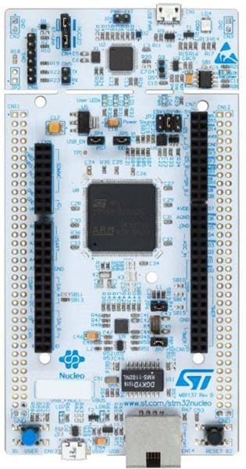

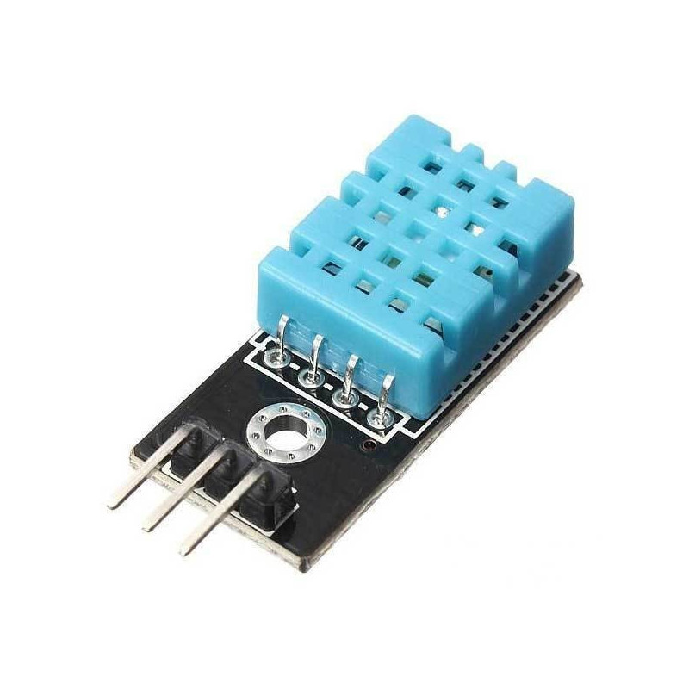
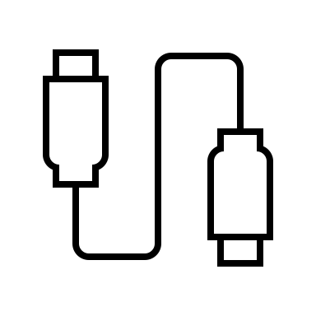
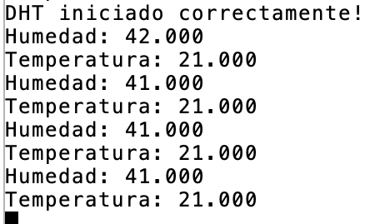
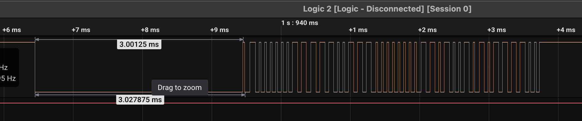

pruebas
VCC
DATA
GND
Figure 7 Logit 2

Slide 10


